Slide 1
Task 2 Atmospheric monitoring using ESP8266 – NODEMCU 12Ewith MQ135 and DHT 11and Thingspeak Cloud Computing

Slide 2
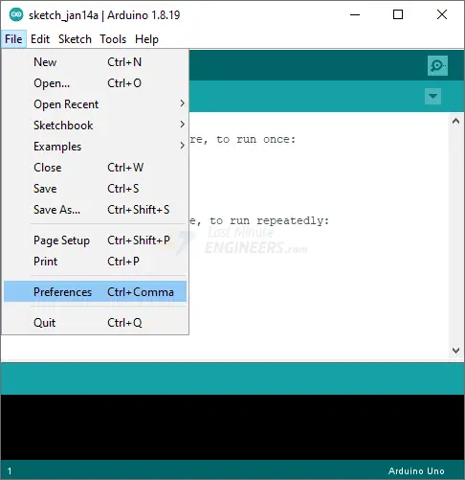
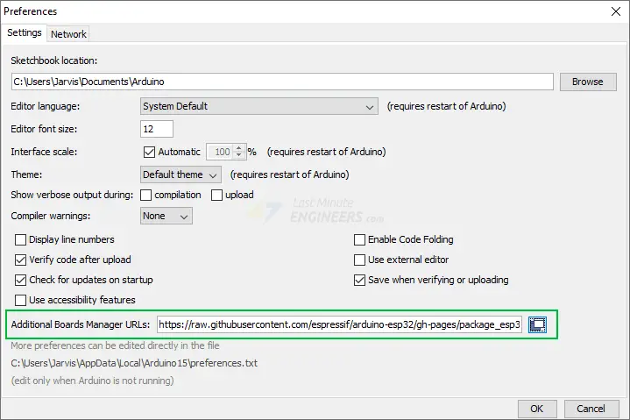
Installing ESP8266 – NODEMCU 12E Board in the Arduino IDE
Step 1: Installing or Updating the Arduino IDE
Step 2: Installing the USB-to-Serial Bridge Driver
https://www.silabs.com/products/development-tools/software/usb-to-uart-bridge-vcp-drivers
http://www.wch-ic.com/downloads/CH341SER_ZIP.html Driver for Hardware in the AB3-602 Lab
Step 3: Installing the ESP8266 – NODEMCU 12E
https://dl.espressif.com/dl/package_esp32_index.json, http://arduino.esp8266.com/stable/package_esp8266com_index.json

Slide 3
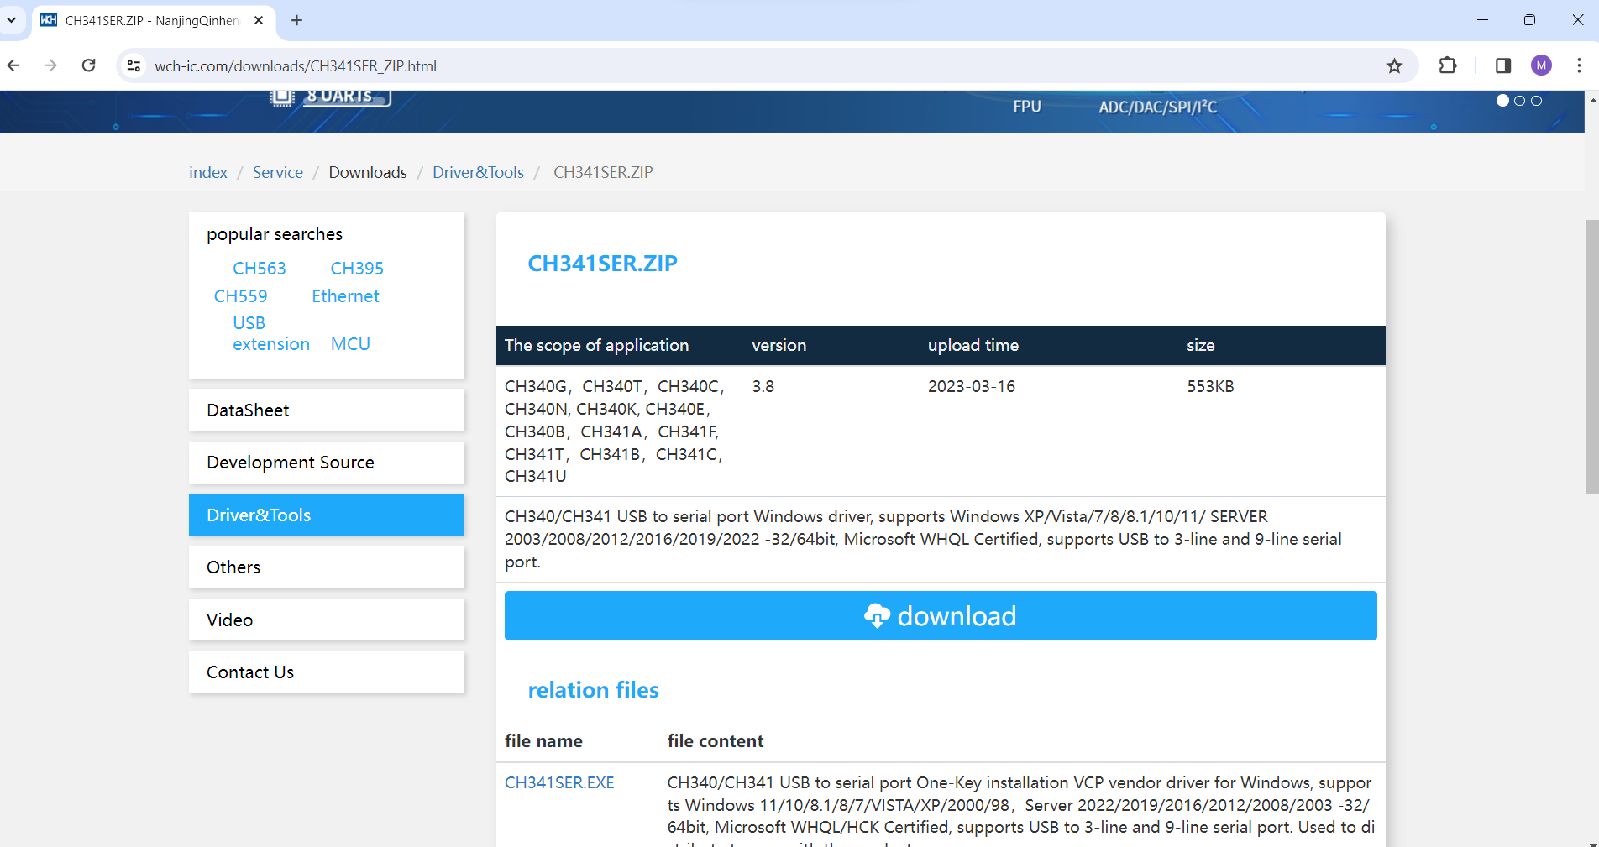
Installing CH341SER drivers for ESP8266 – NODEMCU 12E Board
Step 2: Installing the CH341SER Driver
https://www.silabs.com/products/development-tools/software/usb-to-uart-bridge-vcp-drivers
http://www.wch-ic.com/downloads/CH341SER_ZIP.html Download Driver for Hardware in the AB3-602 Lab

Slide 4
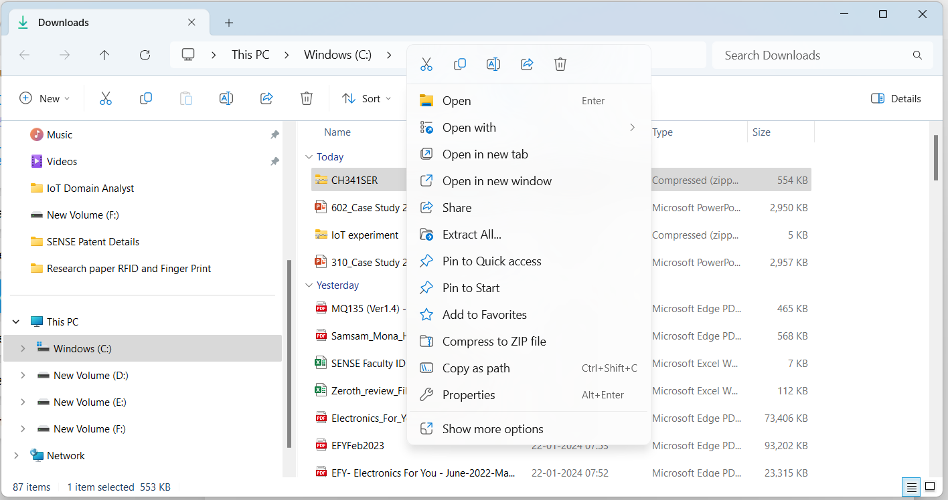
Installing CH341SER drivers for ESP8266 – NODEMCU 12E Board
Step 2: Installing the CH341SER Driver
https://www.silabs.com/products/development-tools/software/usb-to-uart-bridge-vcp-drivers
http://www.wch-ic.com/downloads/CH341SER_ZIP.html Download Driver for Hardware in the AB3-602 Lab
Extract

Slide 5
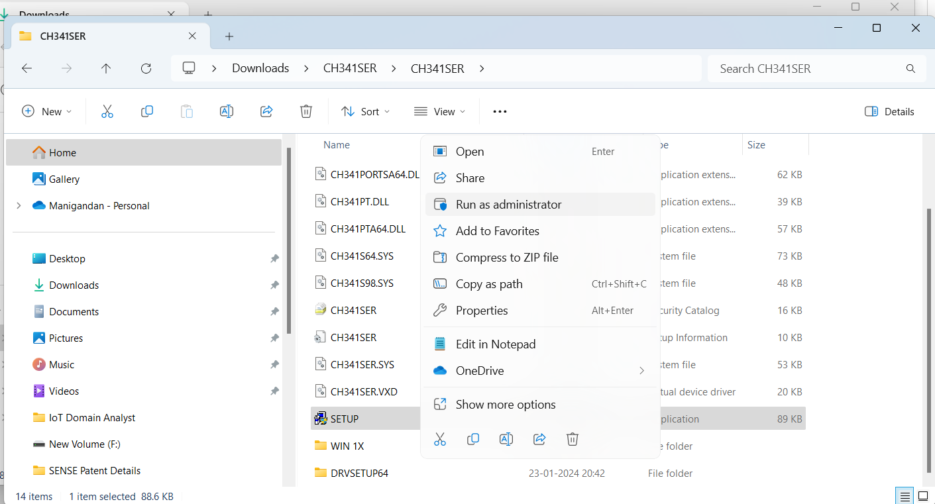
Installing CH341SER drivers for ESP8266 – NODEMCU 12E Board
Step 2: Installing the CH341SER Driver
https://www.silabs.com/products/development-tools/software/usb-to-uart-bridge-vcp-drivers
http://www.wch-ic.com/downloads/CH341SER_ZIP.html Download Driver for Hardware in the AB3-602 Lab
run as administrator

Slide 6
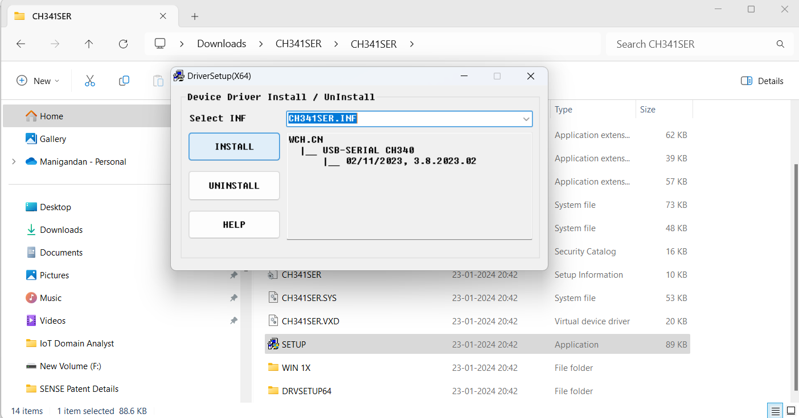
Installing CH341SER drivers for ESP8266 – NODEMCU 12E Board
Step 2: Installing the CH341SER Driver
https://www.silabs.com/products/development-tools/software/usb-to-uart-bridge-vcp-drivers
http://www.wch-ic.com/downloads/CH341SER_ZIP.html Download Driver for Hardware in the AB3-602 Lab
Install

Slide 7
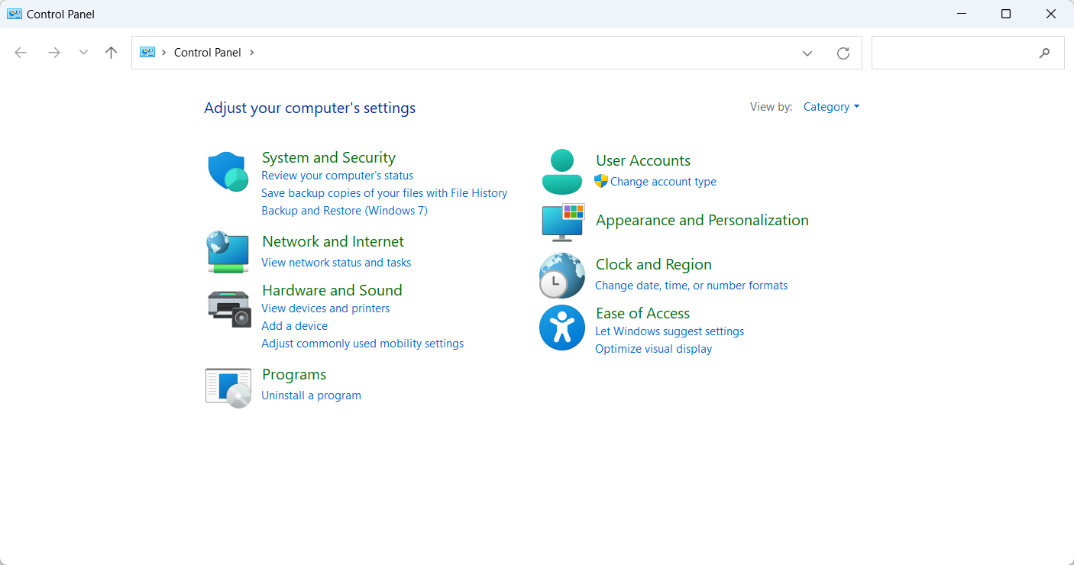
Check for COM Port in Control Panel-> -> Hardware and Sound->Device Manager-> Port COM

Slide 8
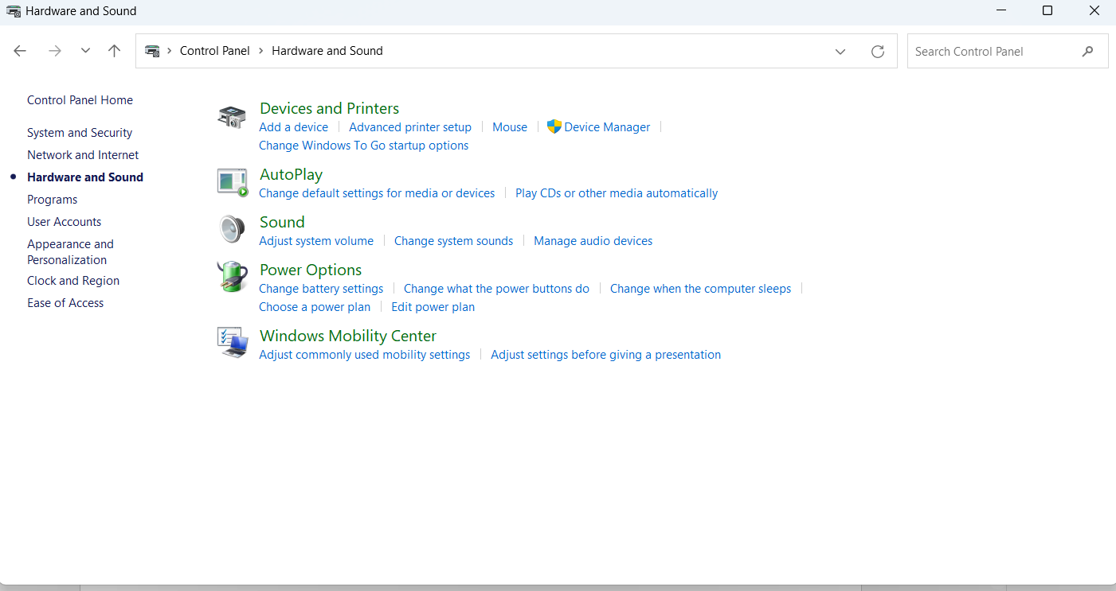
Check for COM Port in Control Panel-> -> Hardware and Sound->Device Manager-> Port COM

Slide 9
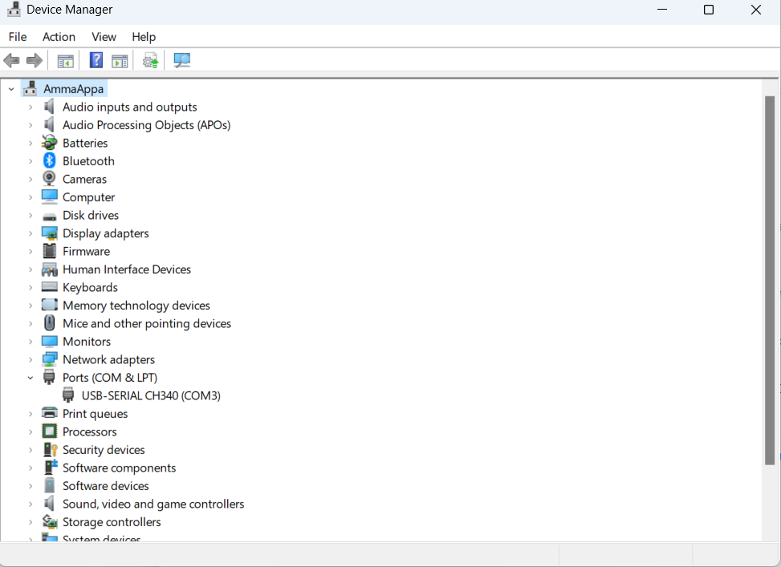
Check for COM Port in Control Panel-> -> Hardware and Sound->Device Manager-> Port COM

Slide 10
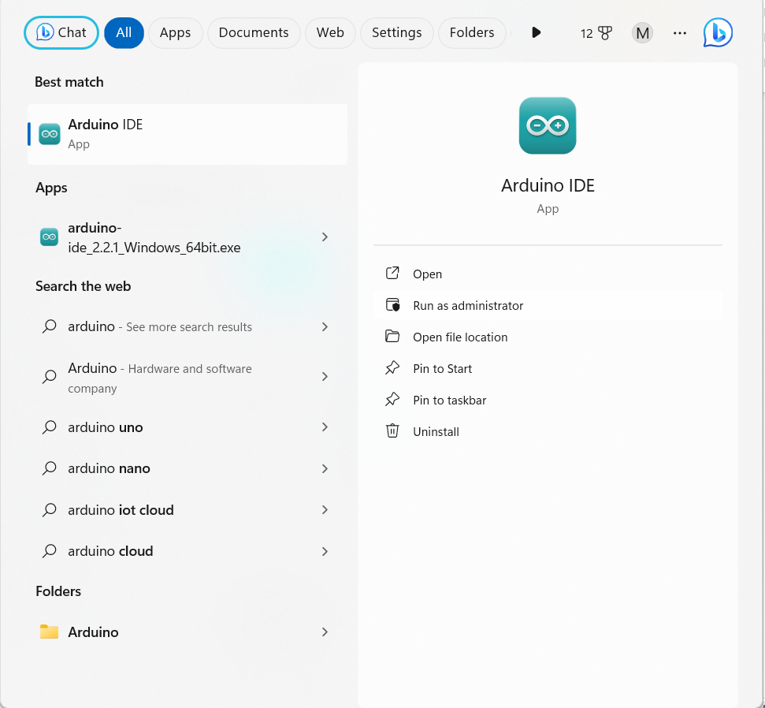
Installing ESP8266 – NODEMCU 12E Board in the Arduino IDE

Slide 11
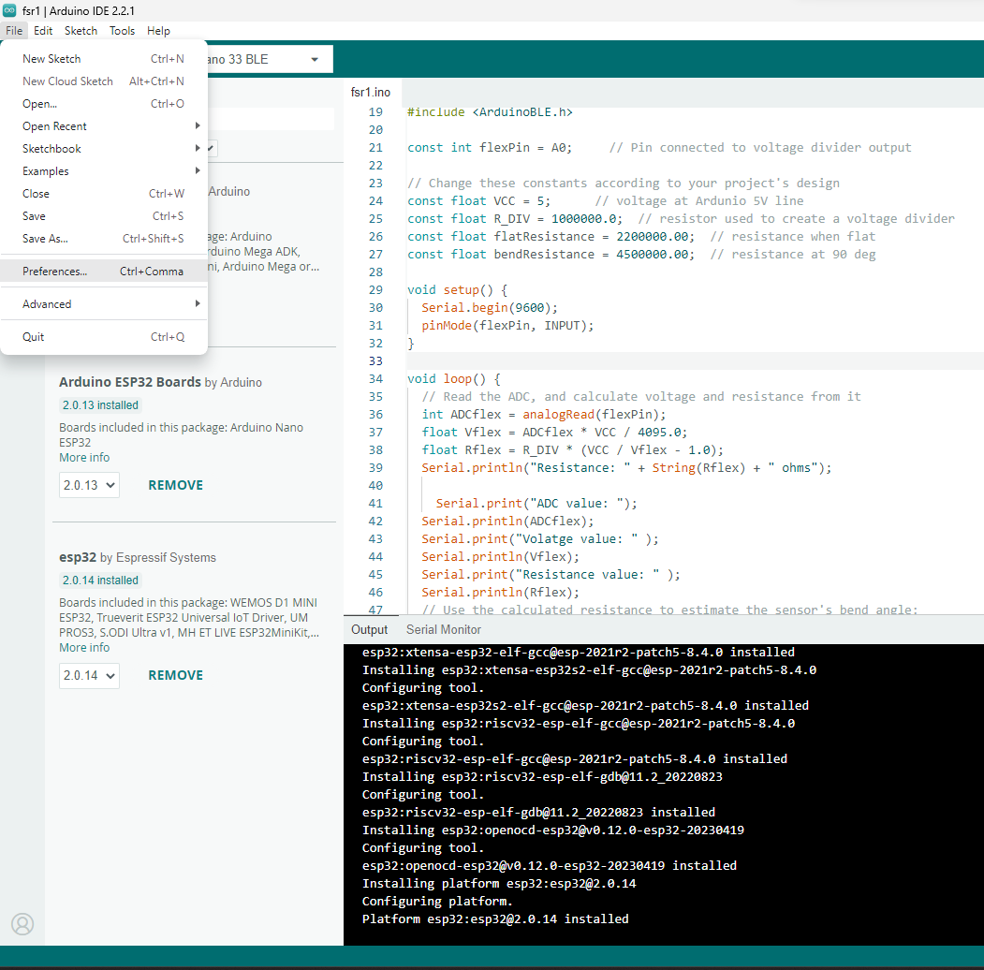
Installing ESP8266 – NODEMCU 12E Board in the Arduino IDE
Step 3: Installing the ESP8266 – NODEMCU 12E Board Core
https://dl.espressif.com/dl/package_esp32_index.json,
http://arduino.esp8266.com/stable/package_esp8266com_index.json

Slide 12
Installing ESP8266 – NODEMCU 12E Board in the Arduino IDE
ESP32 and ESP8266 Libraries
https://dl.espressif.com/dl/package_esp32_index.json,
http://arduino.esp8266.com/stable/package_esp8266com_index.json
Reference: Guidelines
https://randomnerdtutorials.com/how-to-install-esp8266-board-arduino-ide/

Slide 13
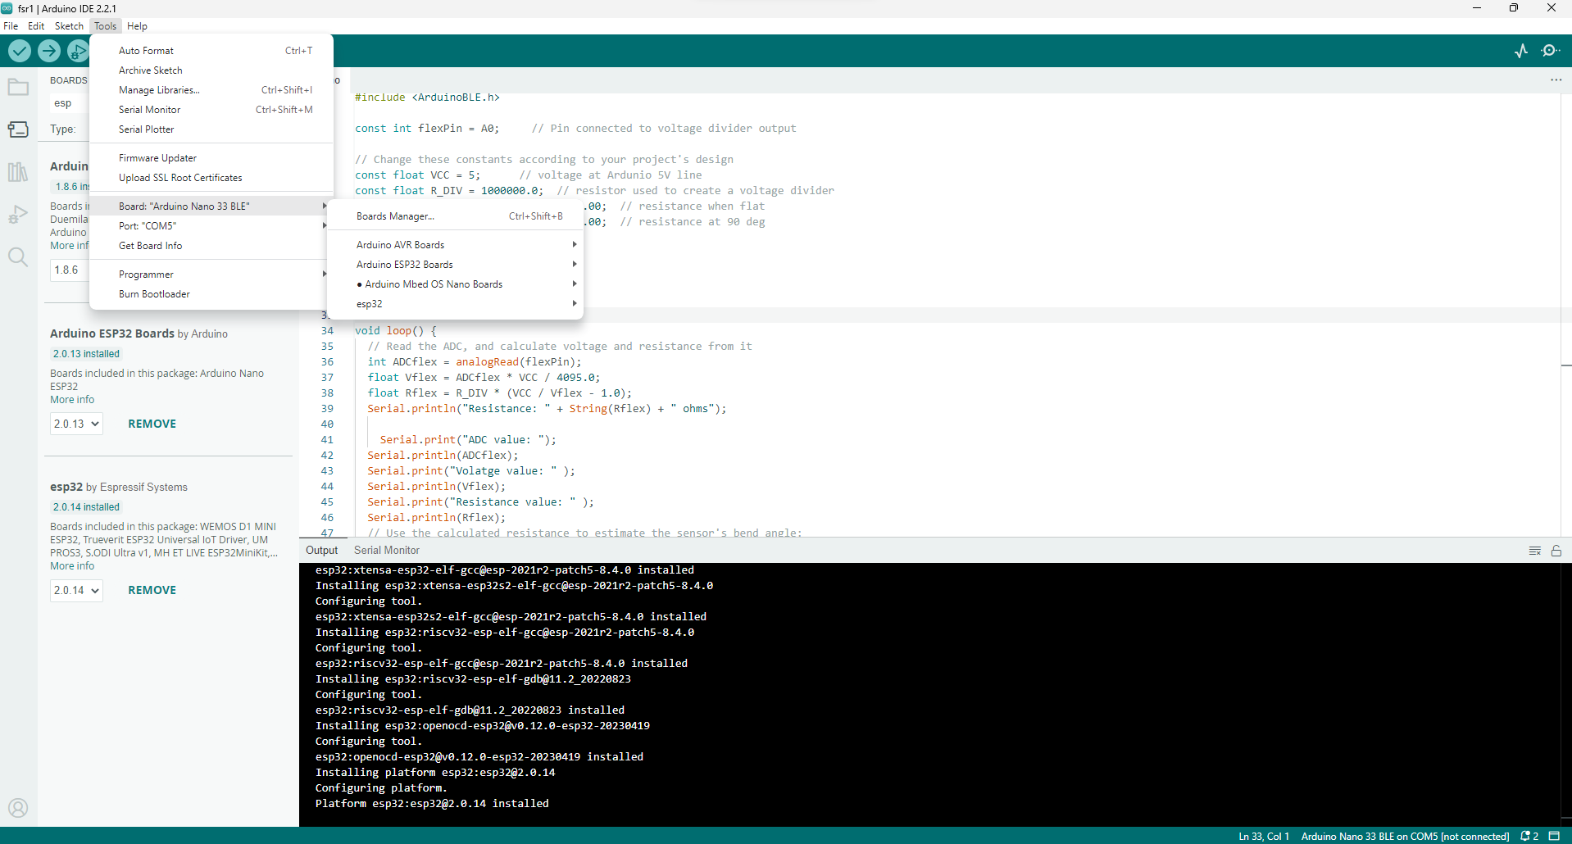
Installing ESP8266 – NODEMCU 12E in the Arduino IDE
Step 3: Installing the ESP8266 – NODEMCU 12E Board Core – Click on Board Manager

Slide 14
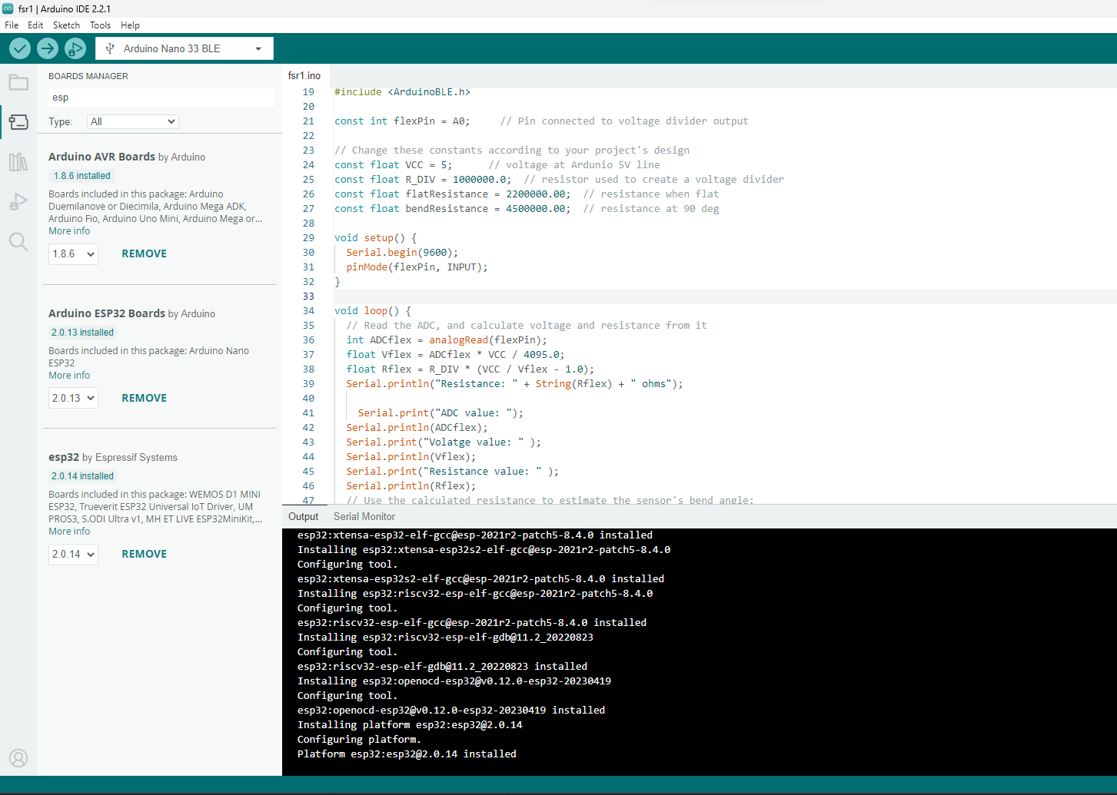
Installing ESP32 Board in the Arduino IDE
Step 3: Installing the ESP8266 – NODEMCU 12E Arduino Core
a. Install Arduino ESP32
b. Install ESP32
By searching the Board

Slide 15
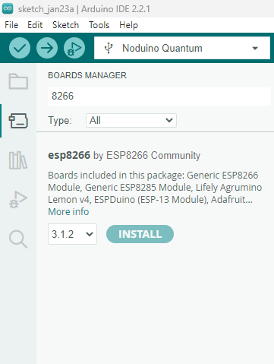
Installing ESP8266 – NODEMCU 12E Board in the Arduino IDE
Step 3: Installing the ESP8266 – NODEMCU 12E Core
Install esp8266
By searching the Board

Slide 16
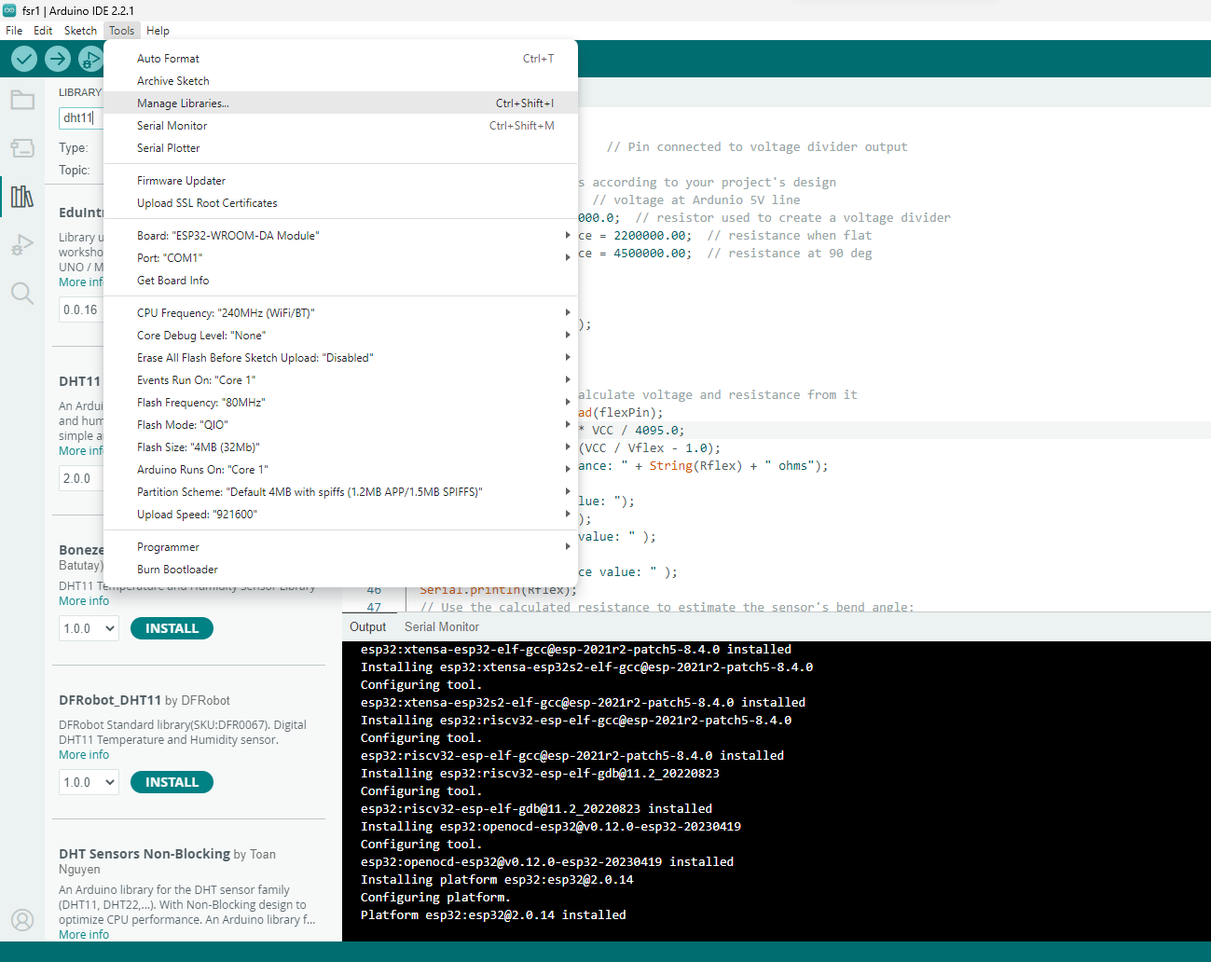
Installing the MQ135 Libraries

Slide 17
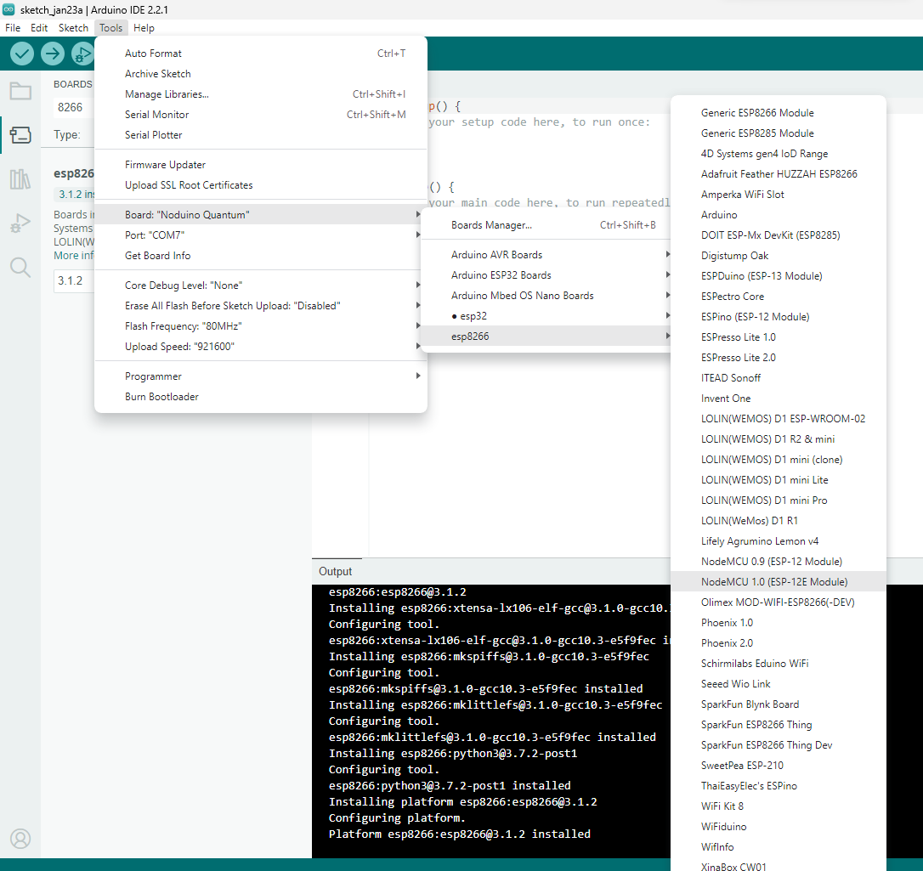
Select the Board
ESP-12E / NodeMCU 1.0

Slide 18
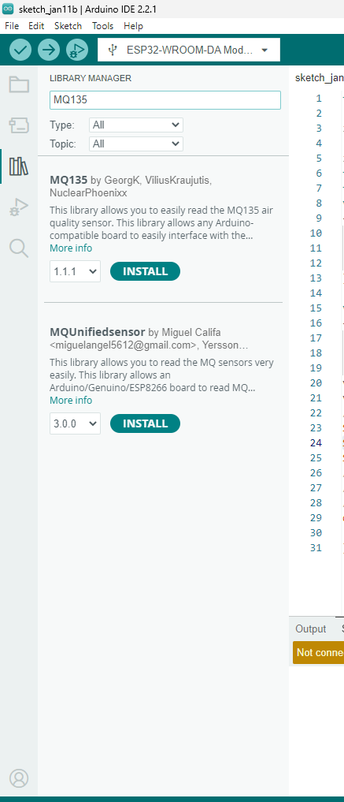
Installing the MQ135 Libraries
Type 135 in the Search tab
a. Install MQ135 &
b. MQUnified Sensor libraries

Slide 19
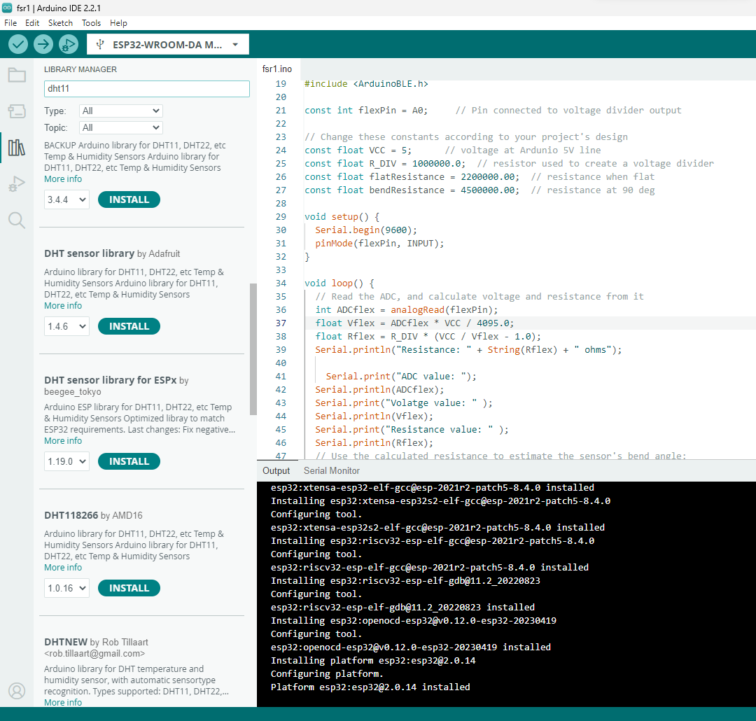
Installing the DHT Libraries
Type DHT11
a. Install DHT Sensor Library
b. Install DHT Sensor Library for ESPx

Slide 20
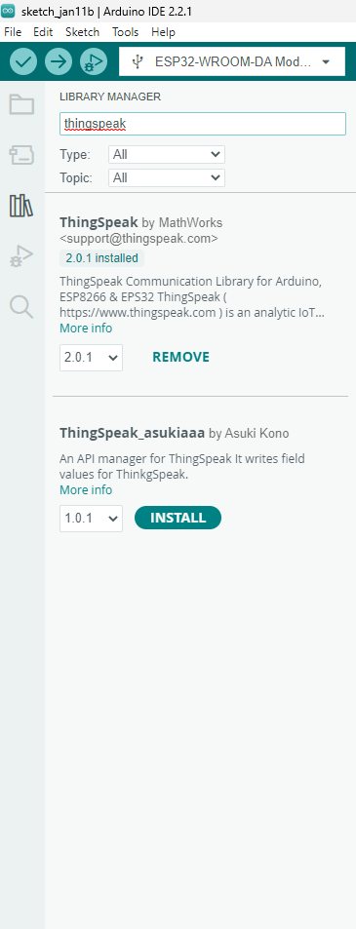
Installing the ThingSpeak Libraries
Type DHT11
a. Install ThingSpeak by Mathworks

Slide 21
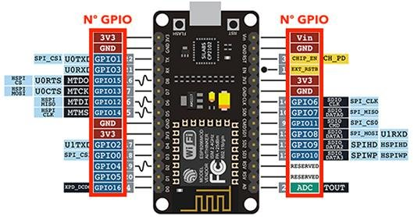
ESP8266 – NODEMCU 12E
Courtesy:
Last Minute Engineers.com

Slide 22
ESP8266 – NODEMCU 12E
Sensor | NodeMCU 12E
DHT11 +Vcc (+) Dout/OUT GND (-) | PIN in NodeMCU +3.3V GPIO2 (D4) hardware connection In software: GPIO2 is Referred as PIN2 for digital input GND (G)
Courtesy:
Last Minute Engineers.com

Slide 23
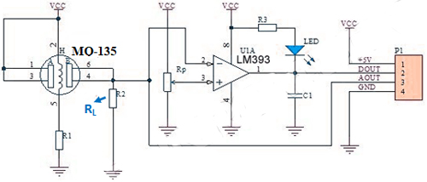
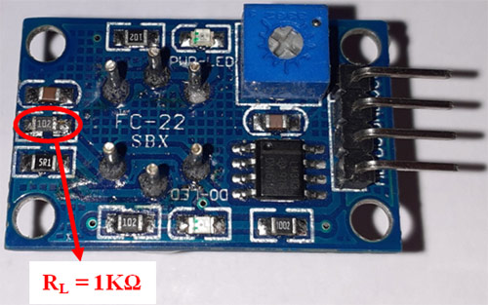
ESP8266 – NODEMCU 12E – MQ135
Sensor | NodeMCU 12E
MQ135 +Vcc (+) A0 (analog out) | PIN in NodeMCU +3.3V A0 In software: A0 is Referred as Analog output
Courtesy:
Last Minute Engineers.com

Slide 24
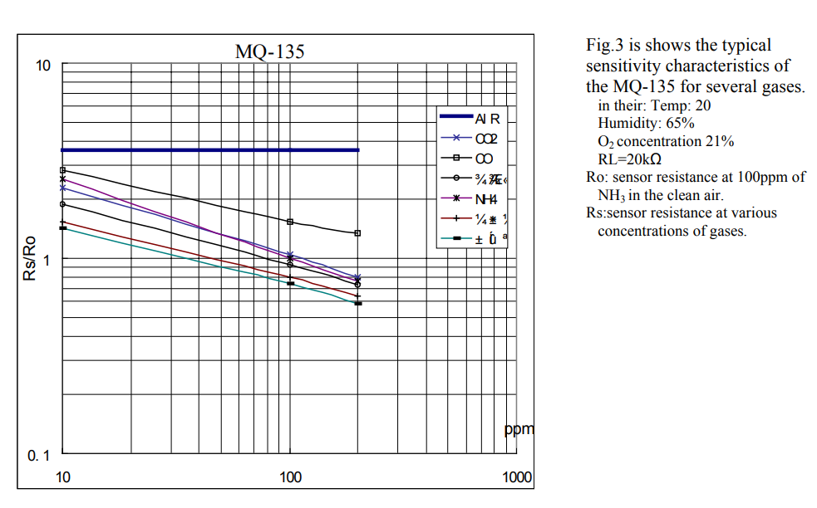
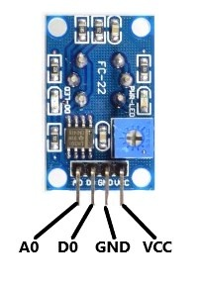
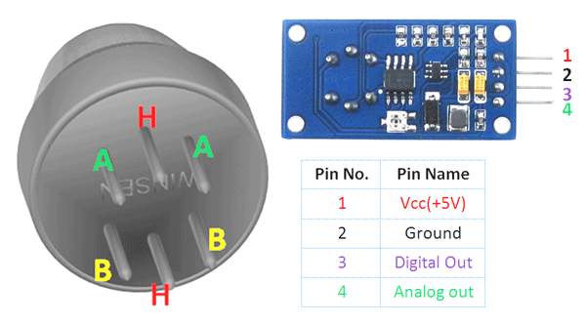
Sensitivity characteristics of the MQ-135 for several gases
Courtesy:
https://components101.com/sites/default/files/component_datasheet/MQ135%20Datasheet.pdf

Slide 25
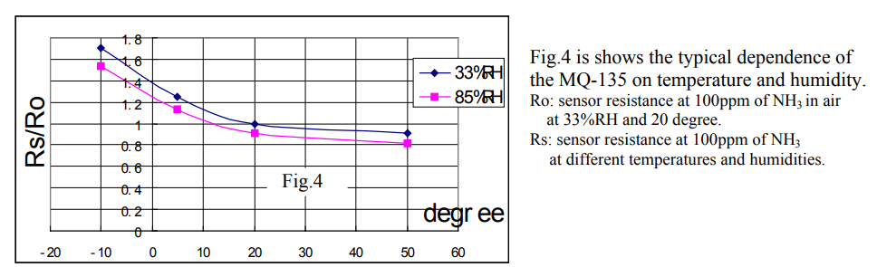
MQ-135 on temperature and humidity
Courtesy:
https://components101.com/sites/default/files/component_datasheet/MQ135%20Datasheet.pdf

Slide 26
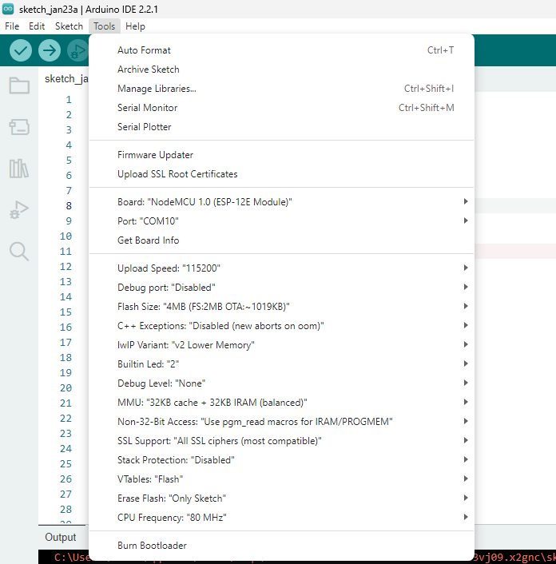
Select the Board NodeMCU 1.0

Slide 27
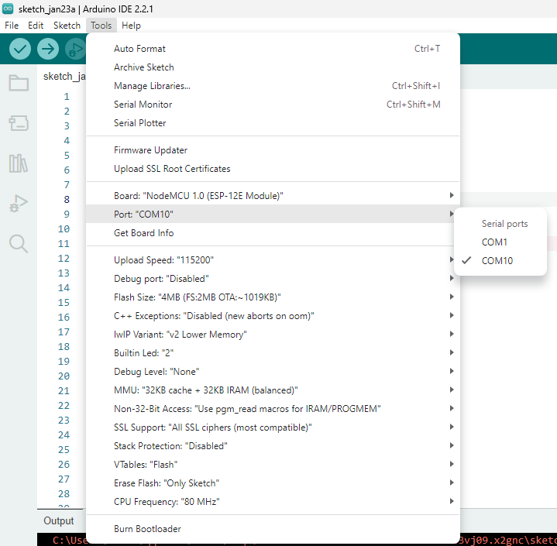
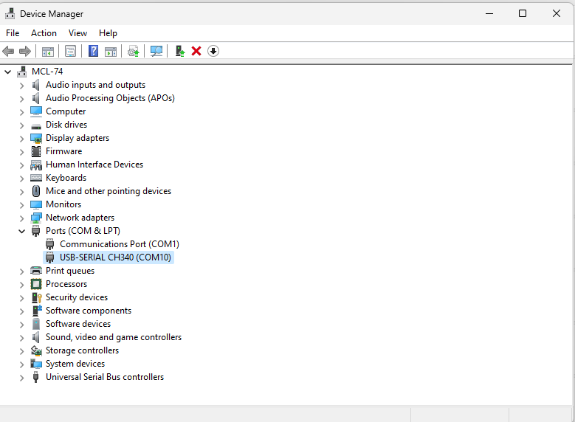
Select the COM port

Slide 28
ESP8266 – NODEMCU 12E (Air Pollution Monitoring and temperature)
Parameters:
Humidity
Temperature
Different Gas Monitoring
Are the both fields or variables to transfer the data from the hardware to the Thingspeak cloud for data visualization

Slide 29
NodeMCU (Environmental Program –DHT11 Check)
#include <ESP8266WiFi.h>
#include <DHT.h>
#include <ThingSpeak.h>
const char *ssid = "Amma2";
const char *pass = "8939708340";
DHT dht(D5, DHT11);
WiFiClient client;
long myChannelNumber = 2409309;
const char myWriteAPIKey[] = "28Y35OPZJG17ZXL0";
Wifi connection Since Simulation
No need for representing the
Wifi Name as well as WIFI Password
ThingSpeak Configuration www.thingspeak.com
APIKey:
Need to be represented in programming as well as the Thingspeak for sending the data from hardware to the cloud server thingspeak

Slide 30
NodeMCU (Environmental Program)
void setup() {
// put your setup code here, to run once:
Serial.begin(115200);
WiFi.begin(ssid, pass);
while(WiFi.status() != WL_CONNECTED)
{
delay(200);
Serial.print("..");
}
Serial.println();
Serial.println("NodeMCU is connected!");
Serial.println(WiFi.localIP());
dht.begin();
ThingSpeak.begin(client);
}

Slide 31
NodeMCU (Temperature Programming)
void loop() {
// put your main code here, to run repeatedly:
float h = dht.readHumidity();
float t = dht.readTemperature();
Serial.println("Temperature: " + (String) t);
Serial.println("Humidity: " + (String) h);
ThingSpeak.writeField(myChannelNumber, 1, t, myWriteAPIKey);
ThingSpeak.writeField(myChannelNumber, 2, h, myWriteAPIKey);
delay(100);
}

Slide 32
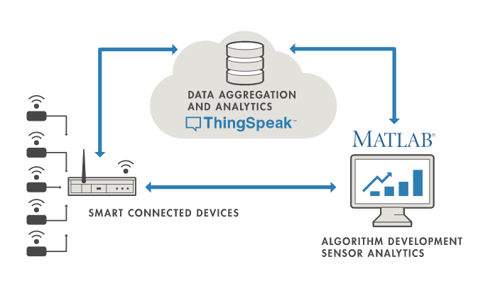
ThingSpeak

Slide 33
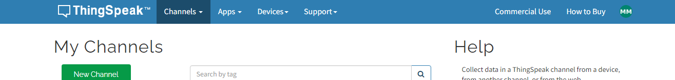
ThingSpeak Configuration for ESP32

Slide 34
ThingSpeak Configuration for ESP32
Channel Settings
Percentage complete: Calculated based on data entered into the various fields of a channel. Enter the name, description, location, URL, video, and tags to complete your channel.
Channel Name: Enter a unique name for the ThingSpeak channel.
Description: Enter a description of the ThingSpeak channel.
Field#: Check the box to enable the field, and enter a field name. Each ThingSpeak channel can have up to 8 fields.
Metadata: Enter information about channel data, including JSON, XML, or CSV data.
Tags: Enter keywords that identify the channel. Separate tags with commas.
Link to External Site: If you have a website that contains information about your ThingSpeak channel, specify the URL.
Show Channel Location:
Latitude: Specify the latitude position in decimal degrees. For example, the latitude of the city of London is 51.5072.
Longitude: Specify the longitude position in decimal degrees. For example, the longitude of the city of London is -0.1275.
Elevation: Specify the elevation position meters. For example, the elevation of the city of London is 35.052.
Video URL: If you have a YouTube™ or Vimeo® video that displays your channel information, specify the full path of the video URL.
Link to GitHub: If you store your ThingSpeak code on GitHub®, specify the GitHub repository URL.
Using the Channel
You can get data into a channel from a device, website, or another ThingsSpeak channel. You can then visualize data and transform it using ThingSpeak Apps.
See Get Started with ThingSpeak" for an example of measuring dew point from a weather station that acquires data from an Arduino® device.

Slide 35
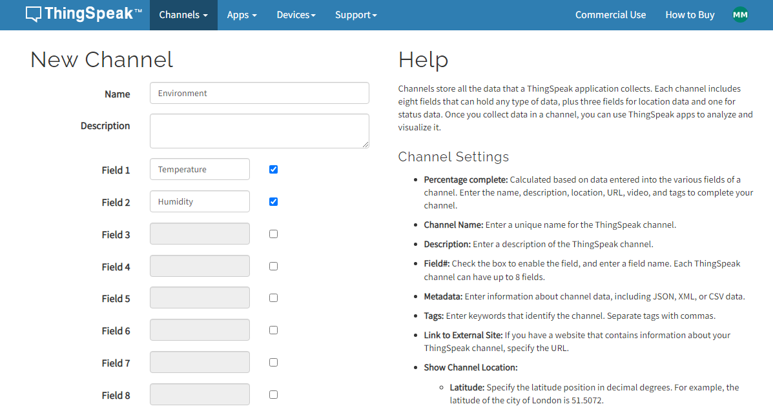
ThingSpeak Configuration for ESP32

Slide 36
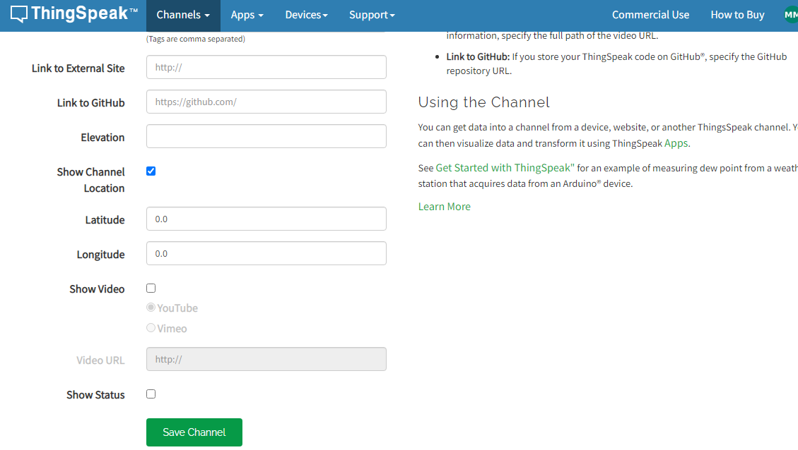
ThingSpeak Configuration for ESP32

Slide 37
ThingSpeak Configuration for ESP32
Save the Channel

Slide 38
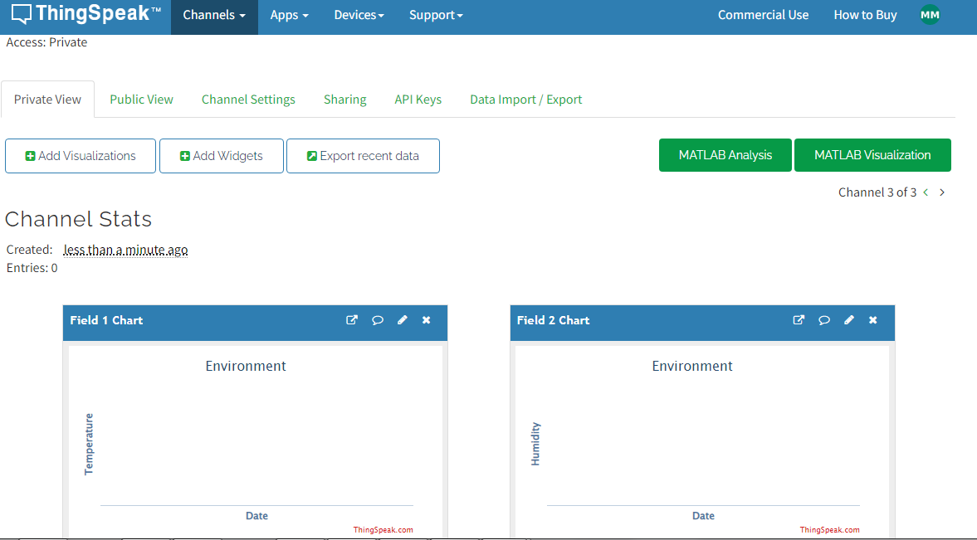
ThingSpeak Configuration for ESP32
Reconfiguring Channel
Note down the Write API Key
Different Visualization

Slide 39
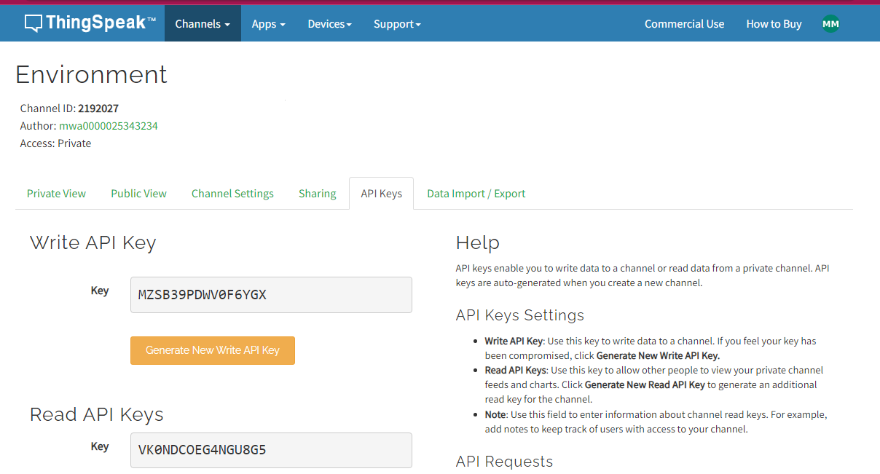
ThingSpeak Configuration for ESP32
Write API Key – Data transfer from Hardware to Thingspeak

Slide 40
ESP8266 – NODEMCU 12E – MQ135
Sensor | NodeMCU 12E
MQ135 +Vcc (+) A0 (analog out) | PIN in NodeMCU +3.3V A0 In software: A0 is Referred as Analog output
Courtesy:
Last Minute Engineers.com

Slide 41
MQ135 Calibration
#include <ESP8266WiFi.h>
//#define RLOAD 10.0
// Calibration resistance at atmospheric CO2 level
//#define RZERO 59
#include "MQ135.h"
MQ135 gasSensor = MQ135(A0);
int val;
int sensorPin = A0;
int sensorValue = 0;
void setup() {
Serial.begin(9600);
pinMode(sensorPin, INPUT);
}
https://www.codrey.com/electronic-circuits/how-to-use-mq-135-gas-sensor/

Slide 42
MQ135 Calibration
void loop() {
val = analogRead(A0);
Serial.print ("raw = ");
Serial.println (val);
float zero = gasSensor.getRZero();
Serial.print ("rzero: ");
Serial.println (zero);
float ppm = gasSensor.getPPM();
Serial.print ("ppm: ");
Serial.println (ppm);
delay(5000);
}
https://www.codrey.com/electronic-circuits/how-to-use-mq-135-gas-sensor/
Output in Serial Monitor

Slide 43
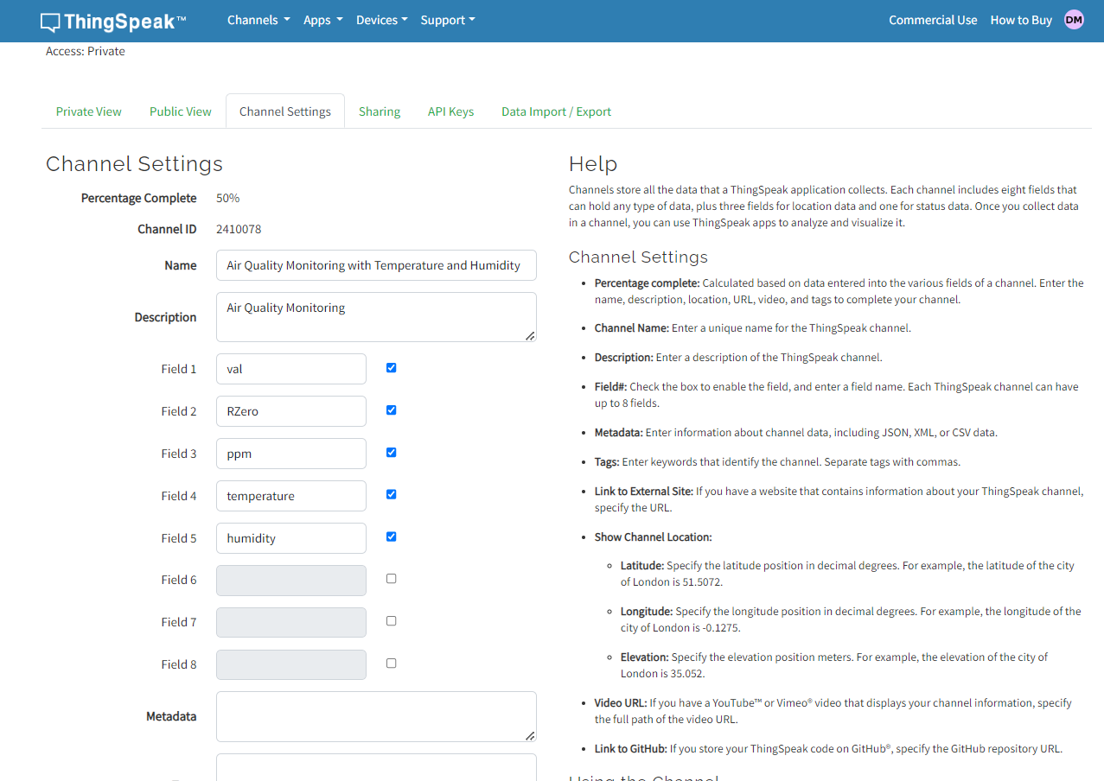
ThingSpeak Channel Setting for Air Quality Monitoring with Temperature and Humidity

Slide 44
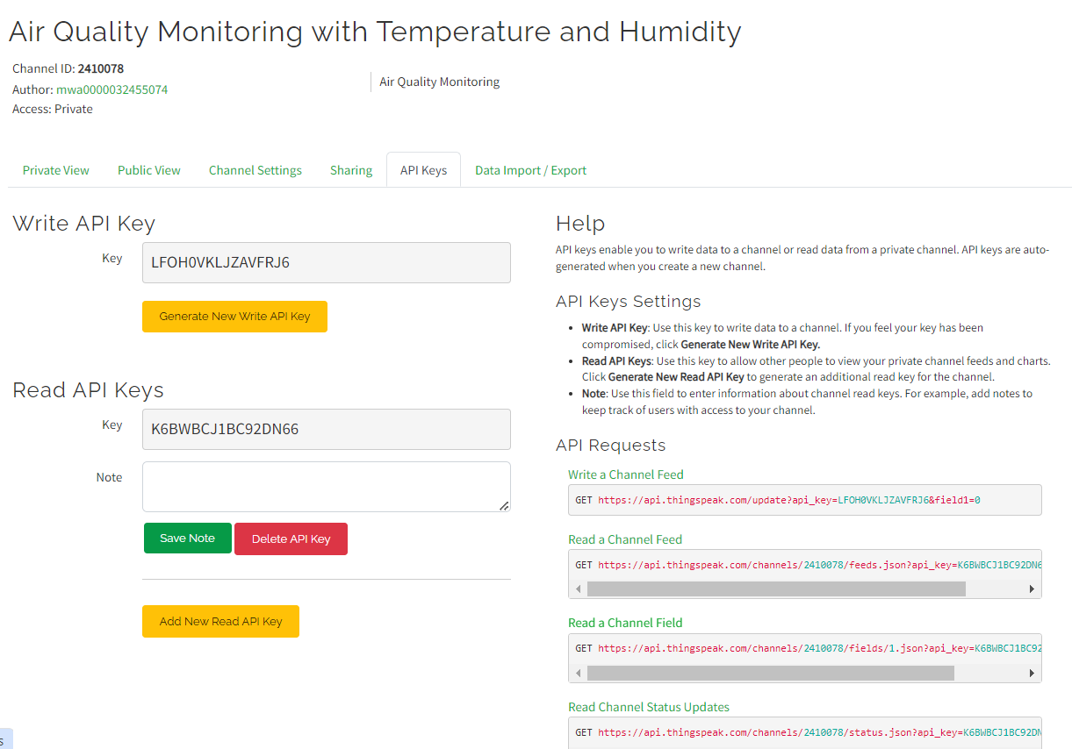
ThingSpeak Channel Setting for Air Quality Monitoring with Temperature and Humidity

Slide 45
Air Quality Monitoring with Temperature and Humidity Code
#include <ESP8266WiFi.h>
#include <DHT.h>
#include <ThingSpeak.h>
#include "MQ135.h"
const char *ssid = "AmmaChennai";
const char *pass = "Mani@05231979";
DHT dht(D5, DHT11);
WiFiClient client;
long myChannelNumber = 2410078;
const char myWriteAPIKey[] = "LFOH0VKLJZAVFRJ6";
// The load resistance on the board
//#define RLOAD 22.0
// Calibration resistance at atmospheric CO2 level
//#define RZERO 879.13
MQ135 gasSensor = MQ135(A0);

Slide 46
Air Quality Monitoring with Temperature and Humidity Code
int val;
int sensorPin = A0;
int sensorValue = 0;
void setup() {
pinMode(sensorPin, INPUT);
// put your setup code here, to run once:
Serial.begin(115200);
WiFi.begin(ssid, pass);
while(WiFi.status() != WL_CONNECTED)
{
delay(200);
Serial.print("..");
}
Serial.println();
Serial.println("NodeMCU is connected!");
Serial.println(WiFi.localIP());
dht.begin();
ThingSpeak.begin(client);
}

Slide 47
Air Quality Monitoring with Temperature and Humidity Code
int val;
int sensorPin = A0;
int sensorValue = 0;
void setup() {
pinMode(sensorPin, INPUT);
// put your setup code here, to run once:
Serial.begin(115200);
WiFi.begin(ssid, pass);
while(WiFi.status() != WL_CONNECTED)
{
delay(200);
Serial.print("..");
}
Serial.println();
Serial.println("NodeMCU is connected!");
Serial.println(WiFi.localIP());
dht.begin();
ThingSpeak.begin(client);
}

Slide 48
Air Quality Monitoring with Temperature and Humidity Code
void loop() {
// put your main code here, to run repeatedly:
float h = dht.readHumidity();
float t = dht.readTemperature();
val = analogRead(A0);
Serial.print ("raw = ");
Serial.println (val);
float zero = gasSensor.getRZero();
Serial.print ("rzero: ");
Serial.println (zero);
float ppm = gasSensor.getPPM();
Serial.print ("ppm: ");
Serial.println (ppm);
Serial.println("raw: " + (String) val);
Serial.println("Rzero: " + (String) zero);
Serial.println("PPM: " + (String) ppm);

Slide 49
Air Quality Monitoring with Temperature and Humidity Code
ThingSpeak.writeField(myChannelNumber, 1, val, myWriteAPIKey);
ThingSpeak.writeField(myChannelNumber, 2, zero, myWriteAPIKey);
ThingSpeak.writeField(myChannelNumber, 3, ppm, myWriteAPIKey);
Serial.println("Temperature: " + (String) t);
Serial.println("Humidity: " + (String) h);
ThingSpeak.writeField(myChannelNumber, 4, t, myWriteAPIKey);
ThingSpeak.writeField(myChannelNumber, 5, h, myWriteAPIKey);
delay(100);
}

